Slide 1

大模型算法
语言大模型介绍
ZOMI

Slide 2
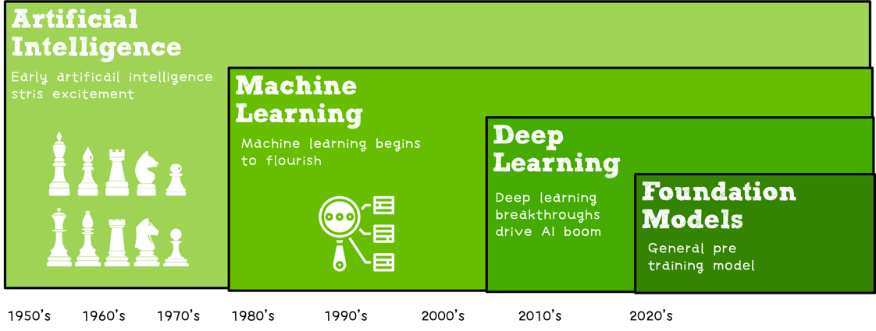

Slide 3
关于本内容
内容背景
大规模分布式训练系统：串行到并行 – 并行处理体系 – 深度学习并行训练
具体内容
大模型训练的挑战：内存墙 – 性能墙 – 效率墙 – 调优墙
分布式训练系统：并行处理硬件架构 – 业界分布式系统分析
分布式并行总体架构：参数服务器模式 – 集合通讯模式
通信原语与协调：通讯协调软硬件 - 通信实现方式 - 通信原语
大模型算法结构：大模型算法发展 – NLP大模型 - CV大模型 – 多模态大模型
分布式并行与同步策略：数据并行 – 模型并行 – 流水并行 – 混合并行
内存和计算优化：ZeRO内存优化 – 混合精度与计算优化

Slide 4
About LLM (Large Language Models)
What are LLM (Large Language Models)
BERT/RoBERTa (Encoder Models)
GPT-3 (Decoder Models)
T5/BART (Encoder Decoder Models)
How to use and Adapt LLM
Prompting for few-shot
Prompting as fine-tuning
In-context learning (Instruction learning)
Downstream Task and Data
NLP downstream Task
Data

Slide 5
What are large language models (LLMs) ?
Language models
narrow sense
broad sense

Slide 6
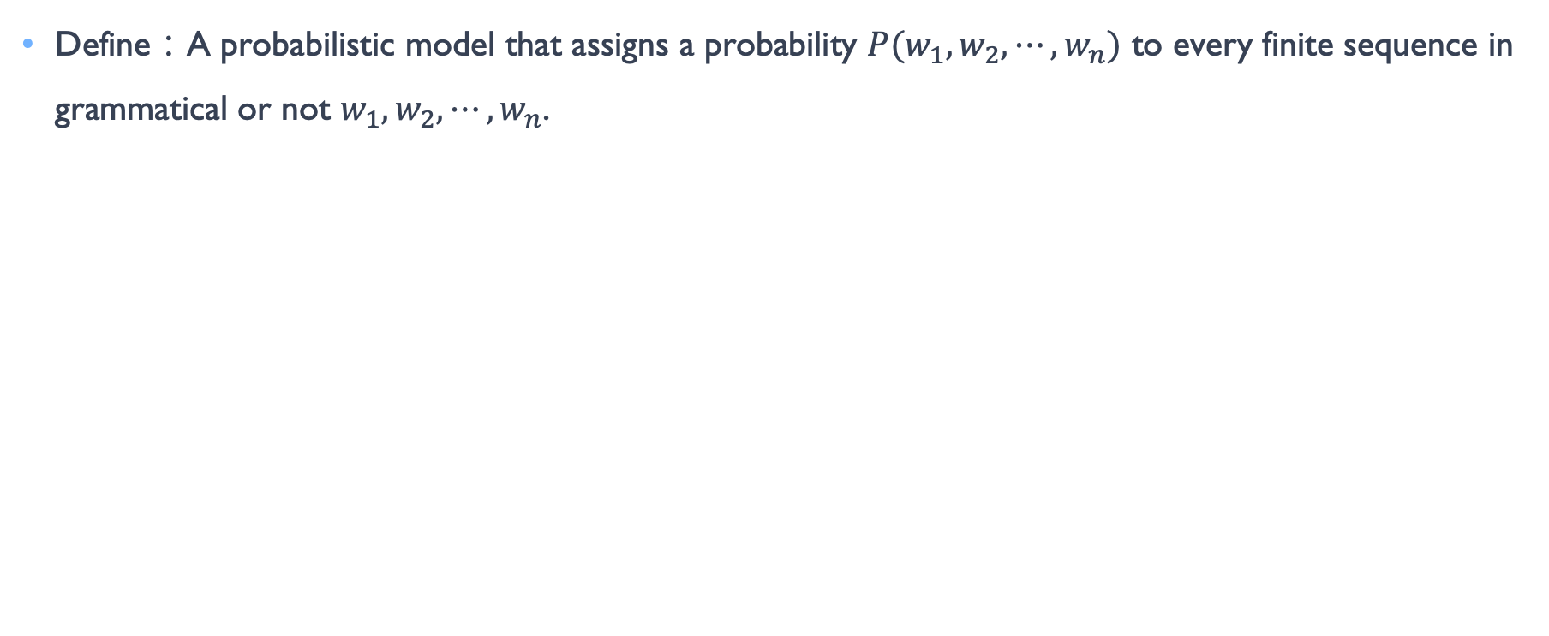
Language models: narrow sense
Define：A probabilistic model that assigns a probability $P(w_{1},w_{2},⋯,w_{n})$ to every finite sequence in grammatical or not $w_{1},w_{2},⋯,w_{n}$.
你儿子在我手上，快点把打过来。 prob=0.80
# 这样一个句子，非常“通顺”，就得到一个很高的概率值。
特朗普在厕所里摆满了多个艺员。 prob=0.20
# 这样一个句子，非常“怪异”，也可能是有别字、语病的，就得到一个很低的概率值。
Notes:
对于语言序列 w1,w2,...,wn，语言模型就是计算该序列的概率，即 P(w1,w2,...,wn)
语言模型是对语句的概率分布的建模

Slide 7
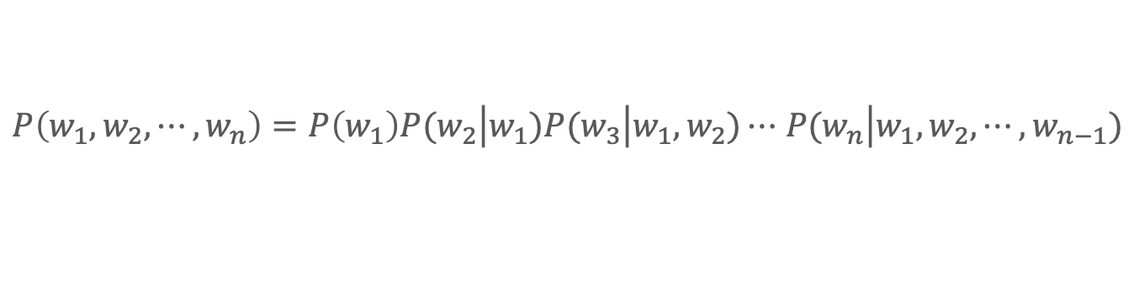
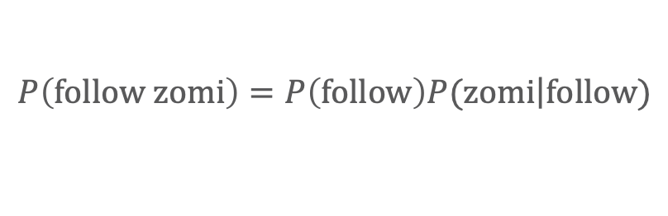
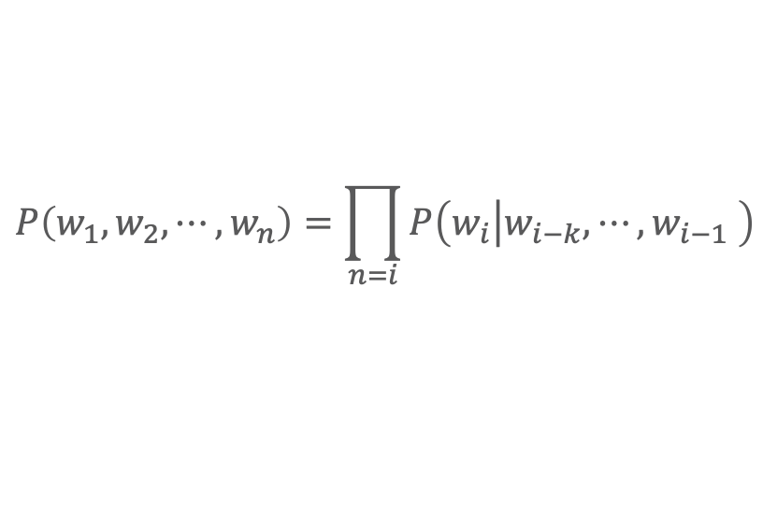
Language models: narrow sense
Write the language model (from word sequence to probability) into a formula.
$P\left(w_{1},w_{2},⋯,w_{n}\right)=P\left(w_{1}\right)P(w_{2}\left|w_{1}\right.)P(w_{3}\left|w_{1},w_{2}\right.)⋯$ $P(w_{n}\left|w_{1},w_{2},⋯,w_{n−1}\right.)$
$$P\left(w_{1},w_{2},⋯,w_{n}\right)=\prod_{n=i}{P\left(w_{i}\left|w_{i−k}, ⋯,w_{i−1}\right. \right)}$$
Example:
$$P\left(follow zomi\right)=P\left(follow\right)P(zomi\left|follow\right.)$$
Notes:
对于语言序列 w1,w2,...,wn，语言模型就是计算该序列的概率，即 P(w1,w2,...,wn)
语言模型是对语句的概率分布的建模

Slide 8
Language models: broad sense
Encoder-only models (BERT, RoBERTa)
Decoder-only models (GPT-3)
Encoder-decoder models (T5, BART)
Notes:
对于语言序列 w1,w2,...,wn，语言模型就是计算该序列的概率，即 P(w1,w2,...,wn)
语言模型是对语句的概率分布的建模

Slide 9
How large can name with Large Language Model?
十亿 = 1 billion
一千万 = 10 million

Slide 10
How large can name with Large Language Model?
Classification two camps of models:
Medium LMs: BERT/RoBERTa models (100M or 300M), T5 models (220M, 770M, 3B)
Large LMs: models of 100+ billion parameters
Larger model sizes:
large parameters
large dataset
large computation
Different sizes of LMs have different ways to adapt:
Fine-tuning
zero-shot/few-shot prompting
in-context learning(Instruction learning)

Slide 11
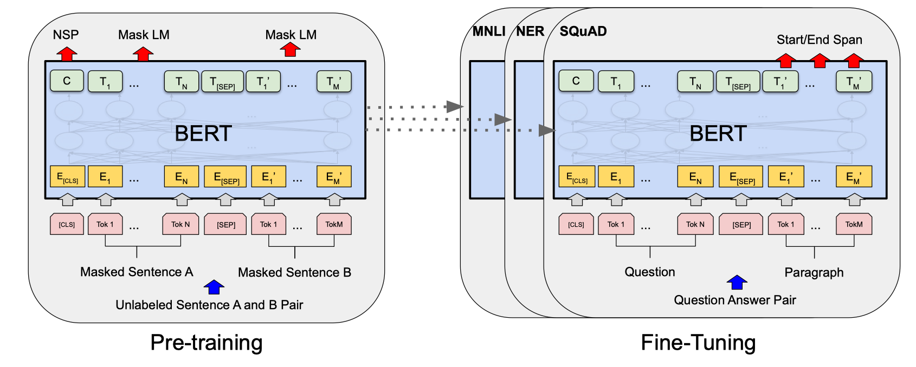
Two Stage: What Pre-training and adaptation?
Pre-training: trained on huge amounts of unlabeled text using “self- supervised” training objectives.
Adaptation: how to use a pre- trained model for downstream task?
What types of NLP downstream tasks?
How many annotated examples have?

Slide 12
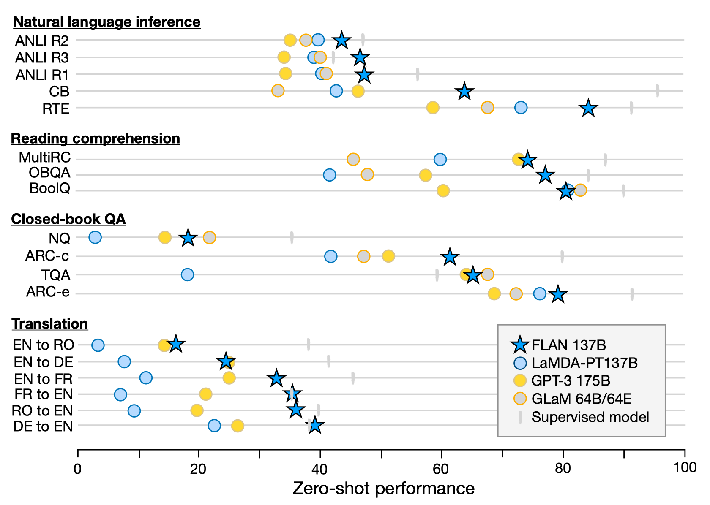
Why Large Language Model?
one single model to solve many NLP tasks.
unlabeled text using “self- supervised”
(Wei et al, FLAN.2022)

Slide 13
Recurrent neural network，RNN
NLP tasks need to be able to process sequence information better, that is, the previous input is related to the subsequent input.

Slide 14
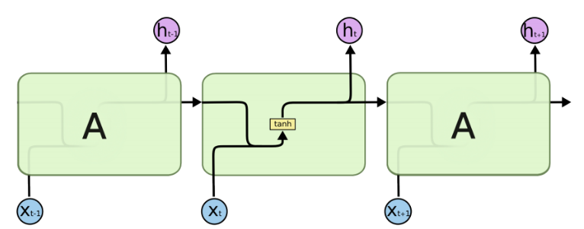
Recurrent neural network，RNN
NLP tasks need to be able to process sequence information better, that is, the previous input is related to the subsequent input.

Slide 15
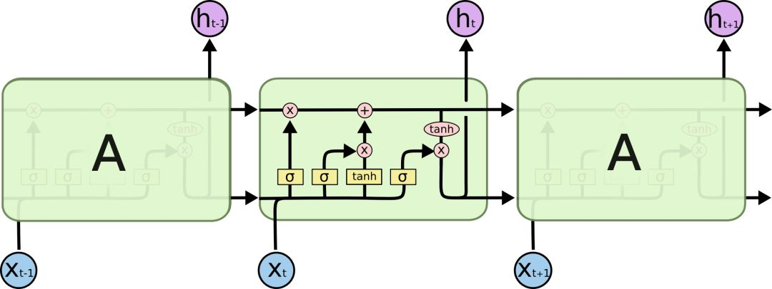
Long Short Term Memory, LSTM
Specially designed to solve the problem of long-term timing dependency.
Prevention of gradient disappearance and gradient explosion in the process of back propagation.

Slide 16
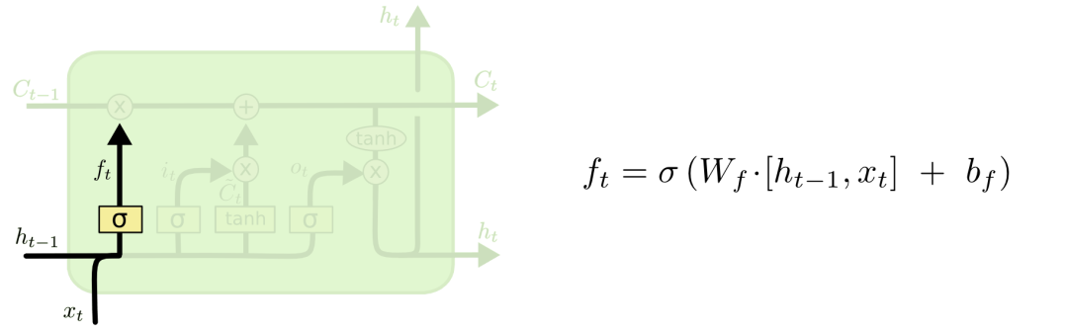
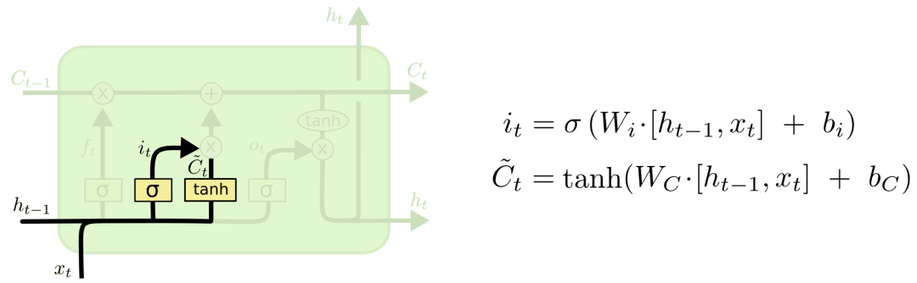
Long Short Term Memory, LSTM
遗忘门（forget gate）
输入门（input gate）

Slide 17
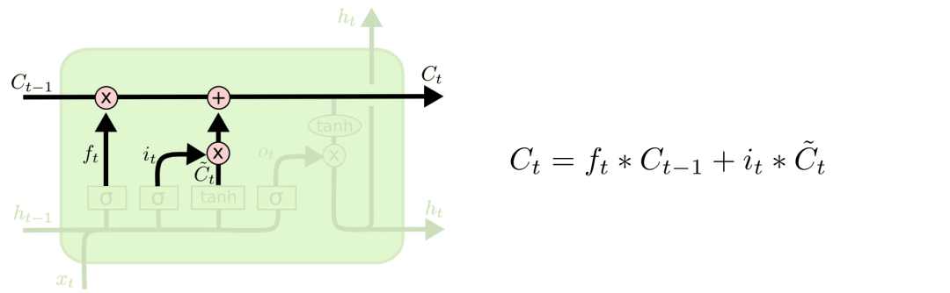
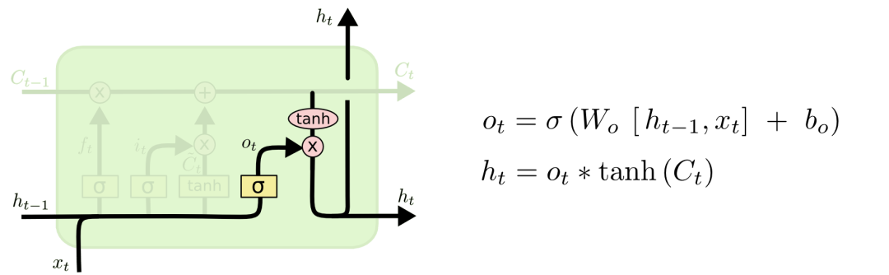
Long Short Term Memory, LSTM
输出门（output gate）

Slide 18
RNN with attention
Effective Approaches to Attention-based Neural Machine Translation,2015

Slide 19
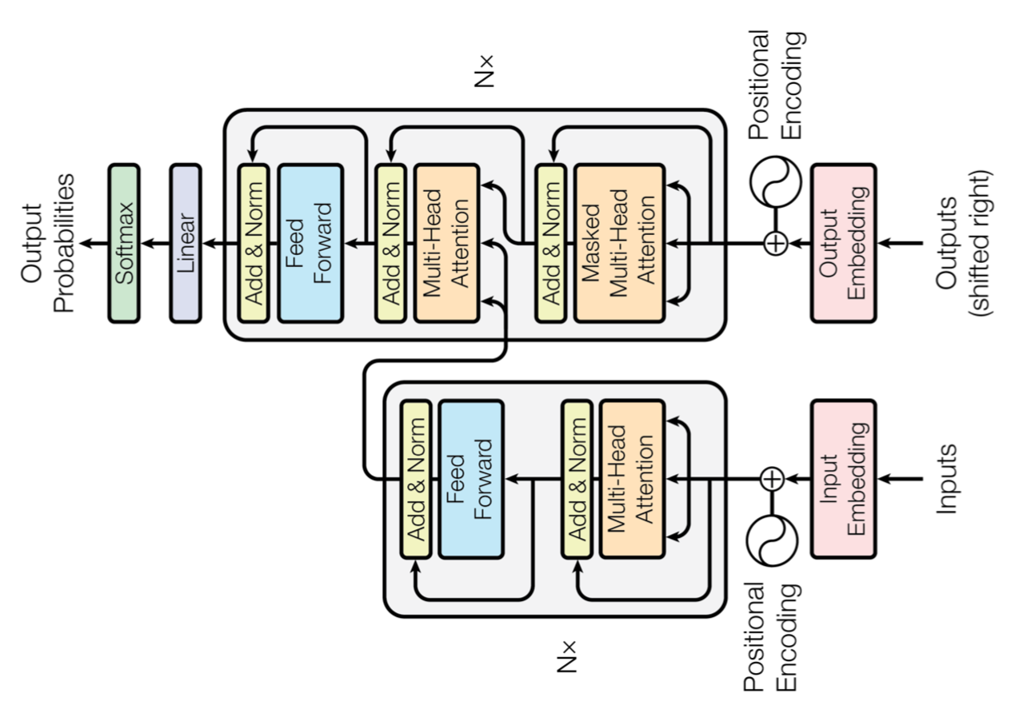
Transformer, Attention is all you need
Vaswani, Transformer, 2017

Slide 20
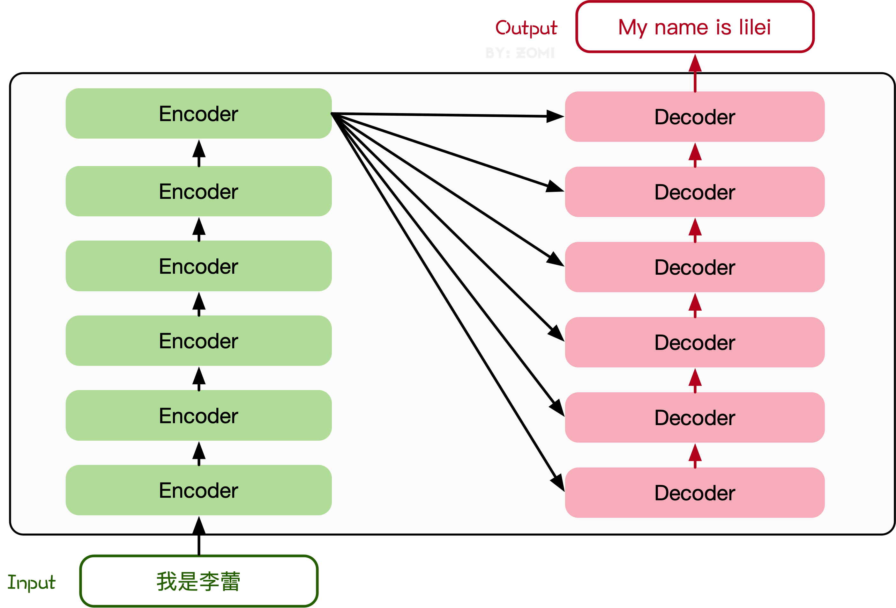
Transformer, Attention is all you need

Slide 21
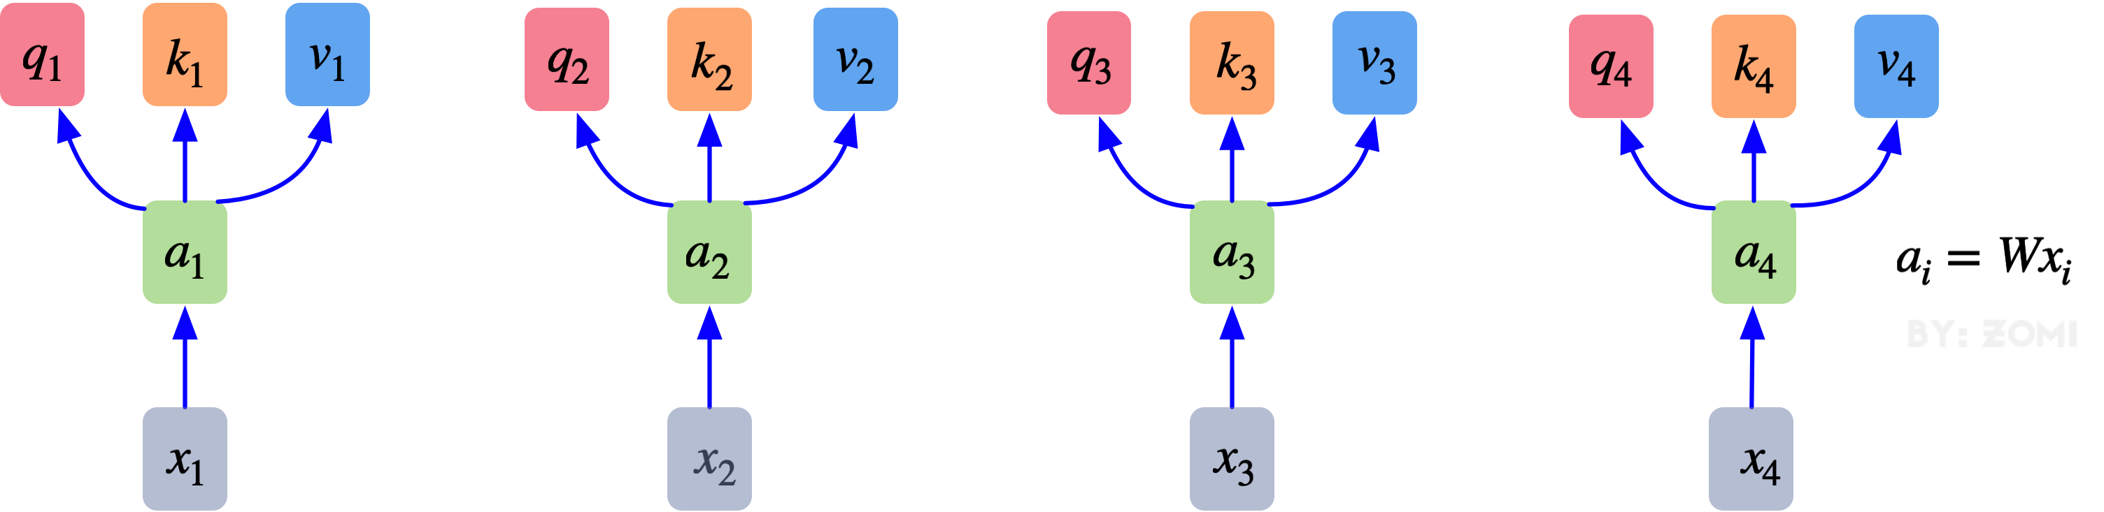
Transformer, Attention is all you need
Attention: the core content is to learn a weight for each word of the input vector. Given a task related query vector, the Query vector calculates the similarity or correlation between Query and each key to obtain the attention distribution, that is, the weight coefficient of the corresponding Value of each key is obtained, and then the value is weighted and summed to obtain the final Attention value.

Slide 22
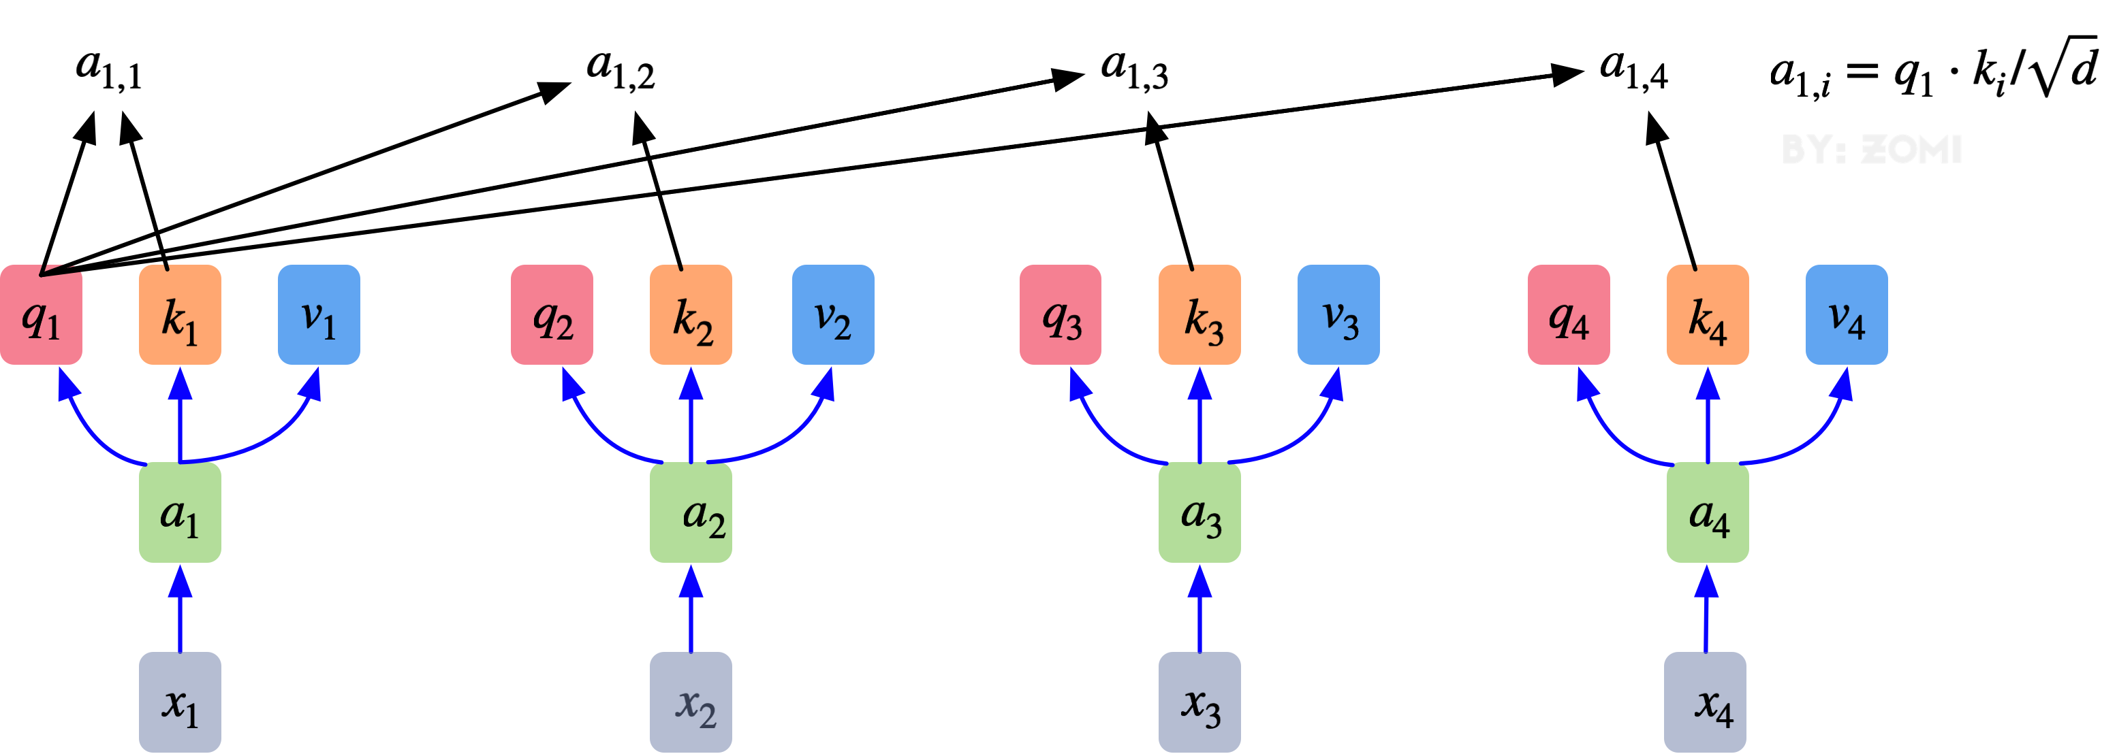
Transformer, Attention is all you need
We need to perform point multiplication on Q and K and divide them by the square root of the dimension. We need to perform Softmax processing on the results of all vectors. Through the operation of formula, we can obtain the relationship weight between vectors.

Slide 23
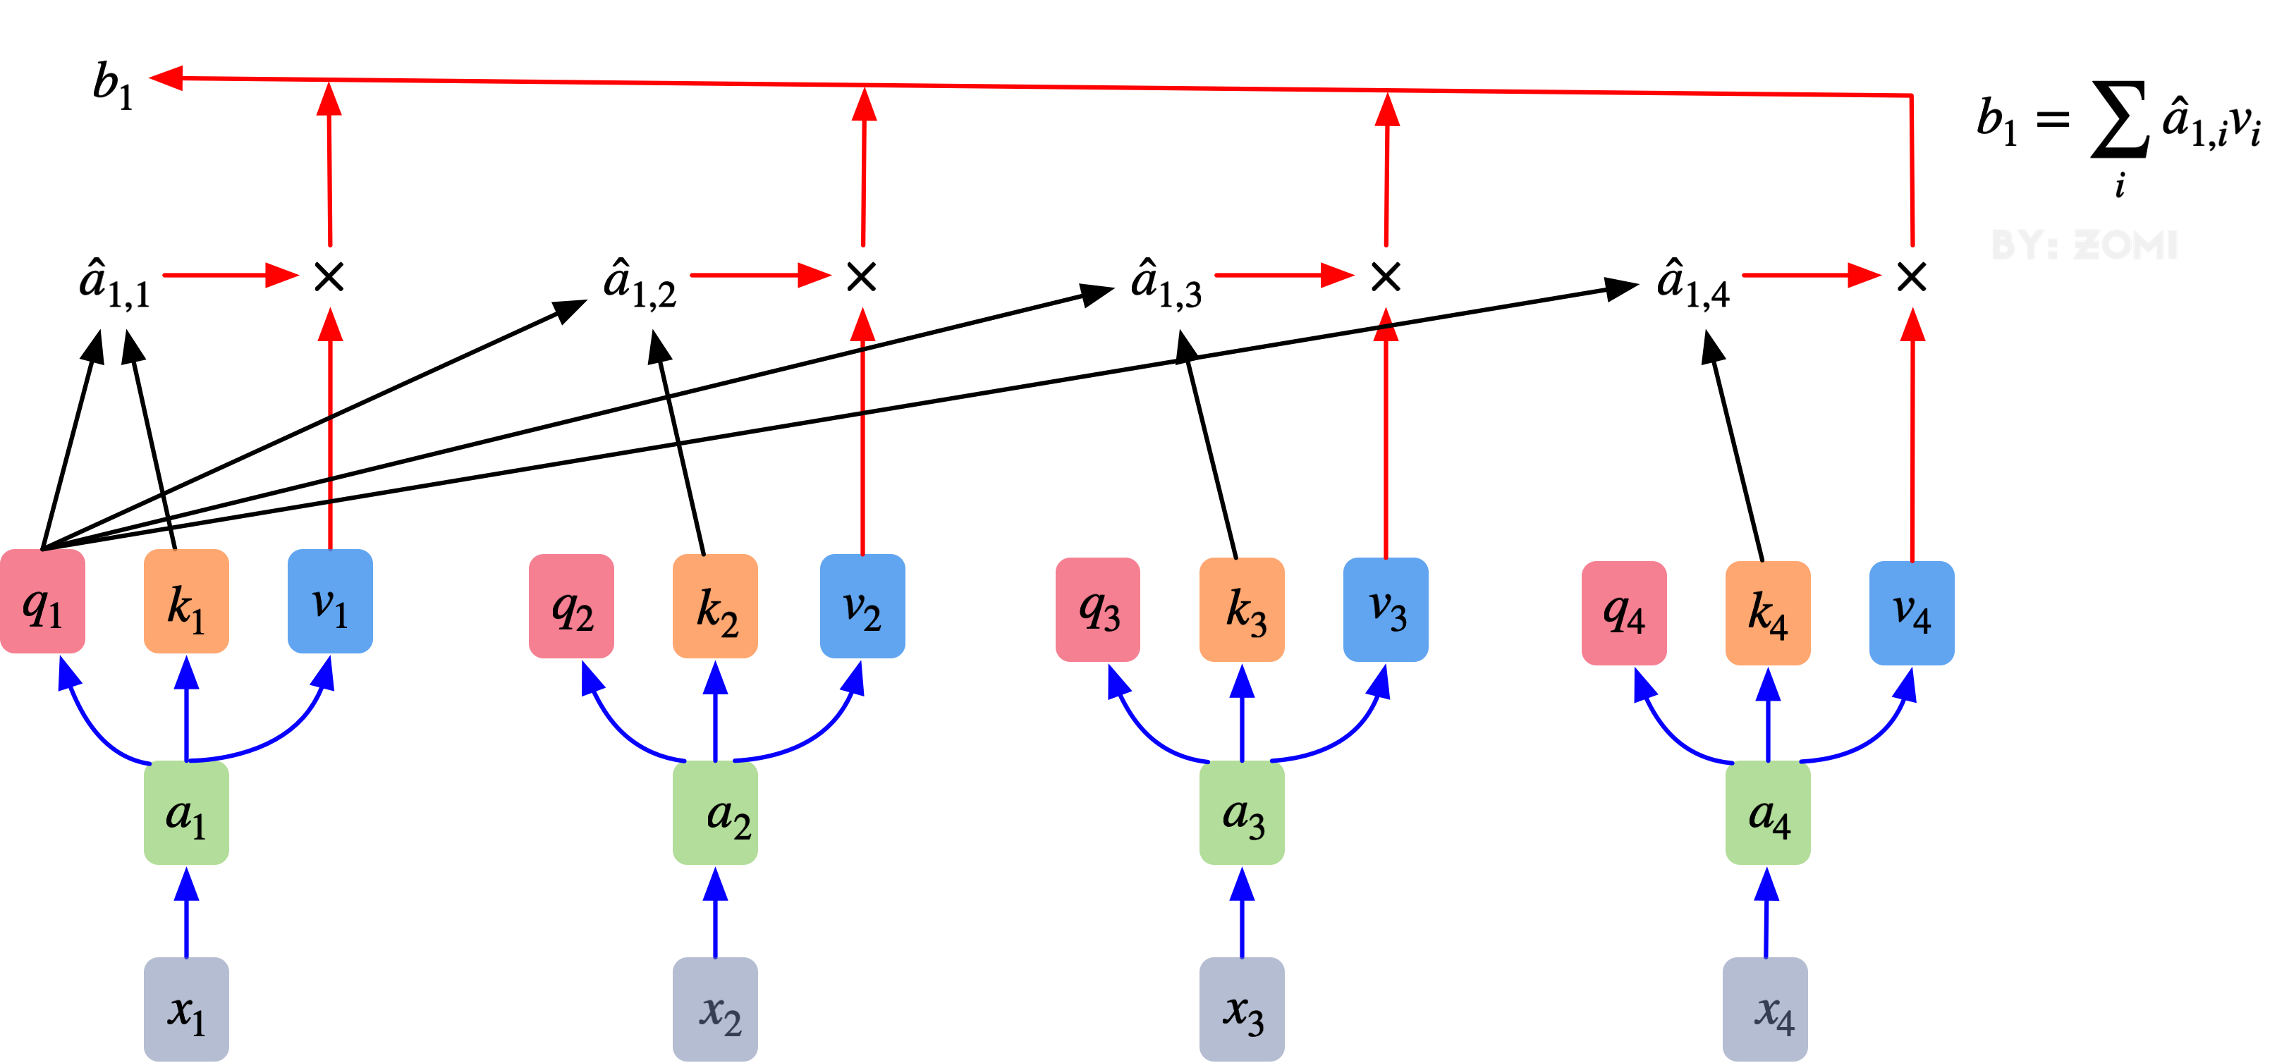
Transformer, Attention is all you need
Each group of QKV finally has a V output, which is the final result obtained by Self Attention and the result obtained by combining the weight of the current vector with other vectors

Slide 24
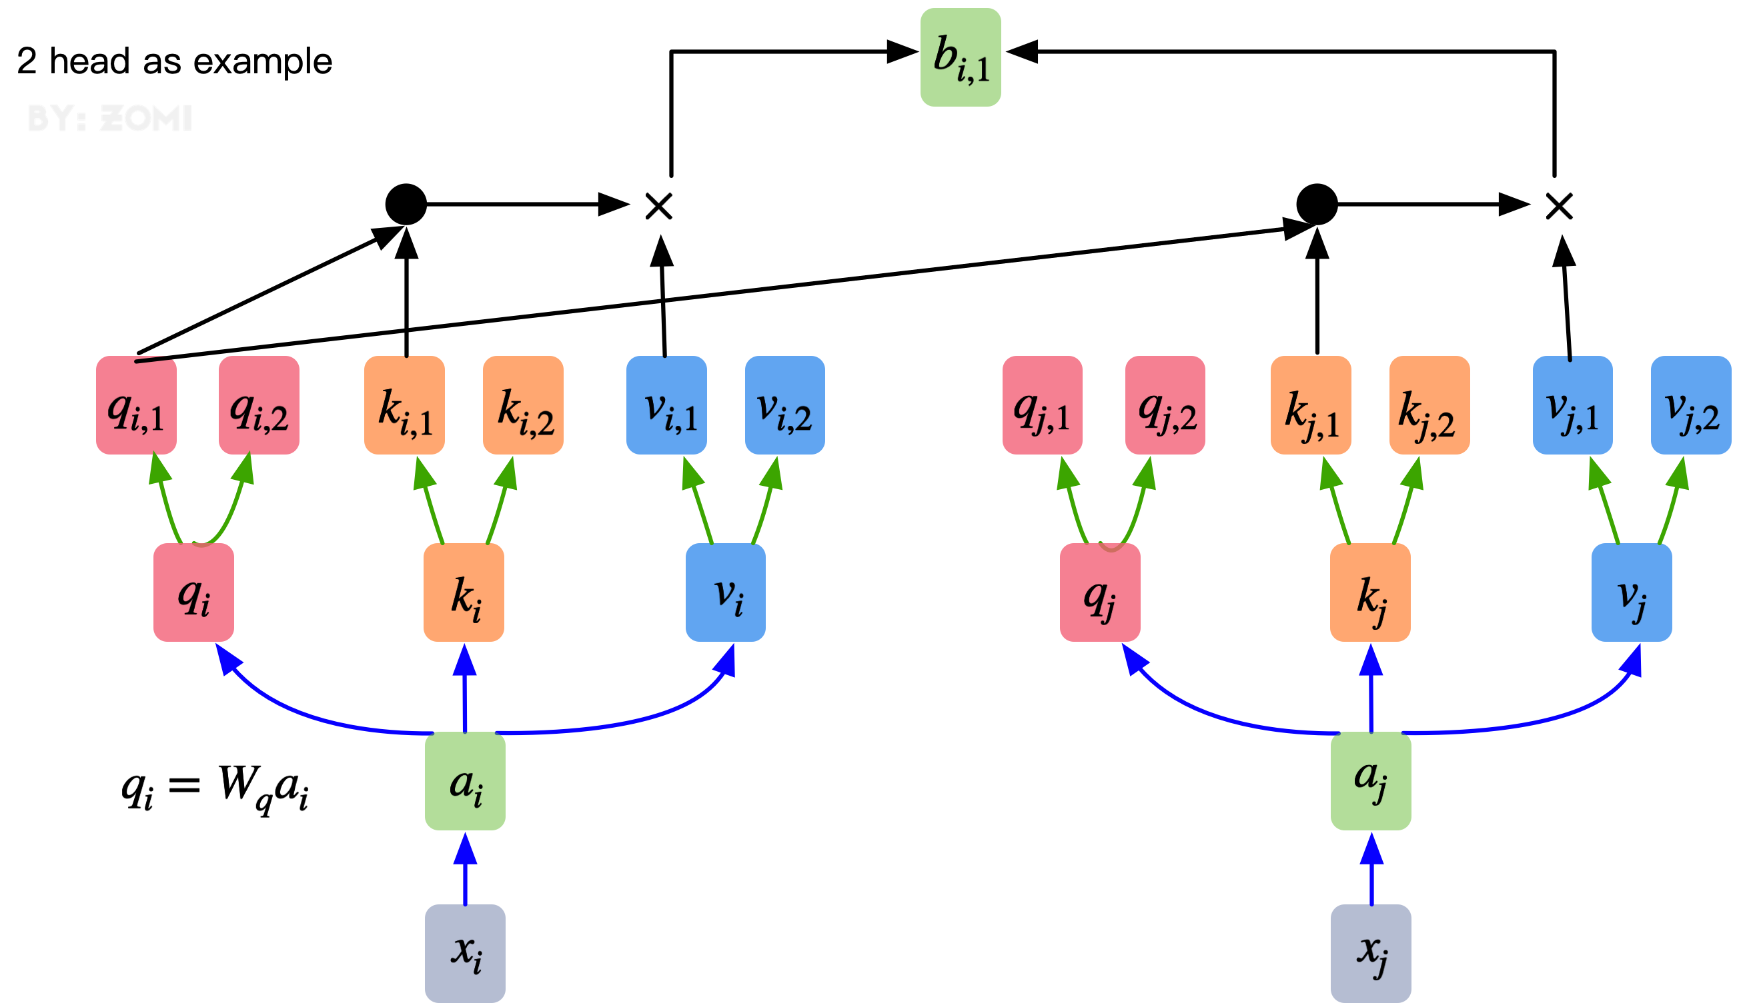
Transformer, Attention is all you need
Multi-Head Attention

Slide 25
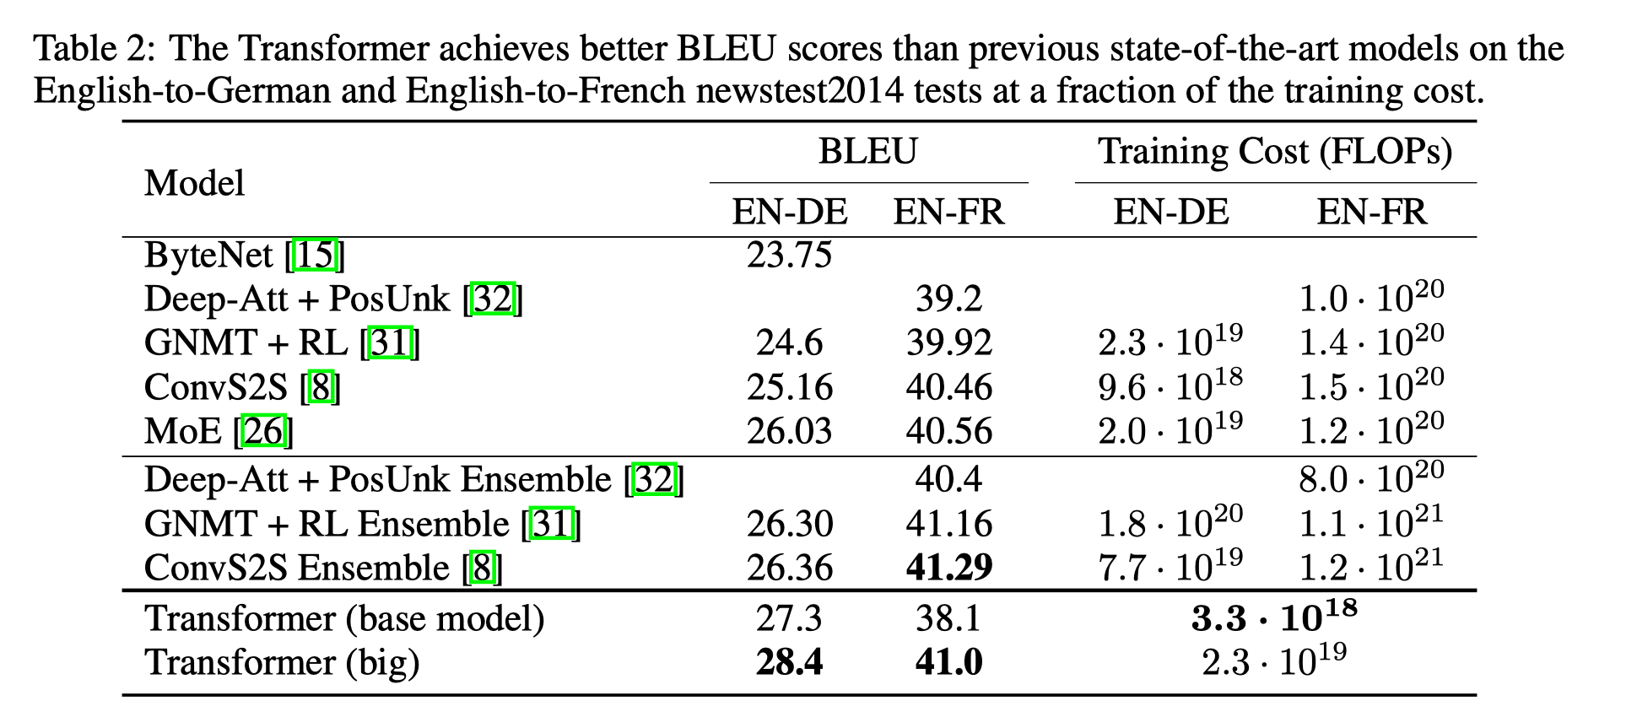
Transformer, Attention is all you need
Transformer solves Seq2Seq problem, replaces LSTM/RNN with a full attention structure:
One step calculation to solve the long-term dependency problem;
The computational complexity of each layer is better;
Point multiplication results can be directly calculated;
Vaswani, Transformer, 2017

Slide 26
Lecture Summary
语言模型的基本定义是对语句的概率分布的建模；
大规模语言模型称为LLM，有效地解决了下游任务繁多、使用无监督学习方法；
传统LM模型主要解决序列问题，后来LSTM的出现解决长时序和梯度消失爆炸问题；
Transformer引入了全注意力机制，通过矩阵乘使得LM模型SOTA，进入LLM时代；

Slide 27
Inference
Transformer. Vaswani, Ashish, et al. "Attention is all you need." Advances in neural information processing systems 30 (2017).
BERT Devlin, Jacob, et al. "Bert: Pre-training of deep bidirectional transformers for language understanding." arXiv preprint arXiv:1810.04805 (2018).
GPT3. Brown, Tom, et al. "Language models are few-shot learners." Advances in neural information processing systems 33 (2020): 1877-1901.
T5. Raffel, Colin, et al. "Exploring the limits of transfer learning with a unified text-to-text transformer." J. Mach. Learn. Res. 21.140 (2020): 1-67.
FLAN. Wei, Jason, et al. "Finetuned language models are zero-shot learners." arXiv preprint arXiv:2109.01652 (2021).
COS 597G (Fall 2022): Understanding Large Language Models. https://www.cs.princeton.edu/courses/archive/fall22/cos597G/

Slide 28
Notes:
28

